Slide 1
IQ-TREE and ancestral sequence reconstruction (ASR)

Slide 2
What is IQ-TREE
What is Ancestral Sequence Reconstruction
constructs phylogenetic trees using various algorithms and models
helps infer evolutionary relationships between species
based on genetic data
one of the features available in IQ-TREE
helps to understand the evolution of specific traits or sequences over time
insights into how modern species have evolved from their ancestors
Infers the traits of ancestors based on the phylogenetic tree and current species data

Slide 3
Overview on IQ-Tree
Utilizes maximum likelihood methods
Supports various evolutionary models
Identifies the best-fit substitution models
Implements several methods for assessing the reliability of the inferred phylogenies
Ultrafast bootstrap
SH-like approximate likelihood ratio tests
Provides tools to infer the traits of ancestral nodes within the phylogenetic tree

Slide 4
ASR in IQ-TREE
To estimate the characteristics
Needs aligned sequence data (DNA, RNA, or protein) from contemporary species
Outputs can be in tabular or tree format, showing the inferred ancestral traits
Users can specify parameters and run ASR analyses using the command-line

Slide 5
Applications
Very user friendly
Command-line interface that is straightforward for users familiar with bioinformatics tools
Comprehensive documentation and tutorials available online to assist users
Evolutionary Biology: Investigating the evolutionary relationships among species
Comparative Genomics: Comparing genetic material across different organisms to understand evolutionary processes
Functional Genomics: Exploring the function and evolution of genes and proteins

Slide 6
Using the software
Downloaded version to use the ASR tools
Software uses a command line that is run in the downloaded terminal
Use command to import the iqtree software into the terminal
Input → multiple alignment sequence
DNA, protein, codon, binary, morphological alignments
File formats: PHYLIP, FASTA, NEXUS, CLUSTALW

Slide 7
Commands
-s | Specifies the input alignment file
-m | Specifies the model of sequence evolution. A combination of letters after will tell what models to use
-asr | Write ancestral sequences (by empirical Bayesian method) for all nodes of the tree
-st | Defines what kind of sequence type

Slide 8
Practical Demonstration

Slide 9
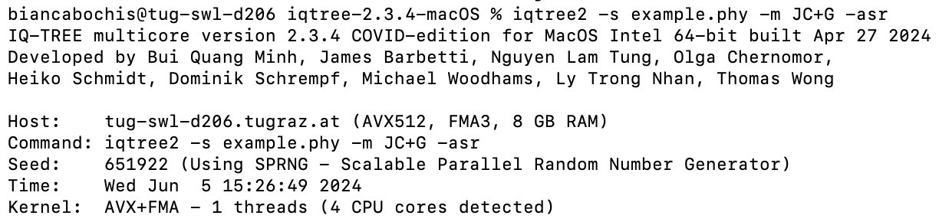
Commands
JC: A simple, equal-rate nucleotide substitution model
G: A model to rate variations across sites using gamma distribution

Slide 10
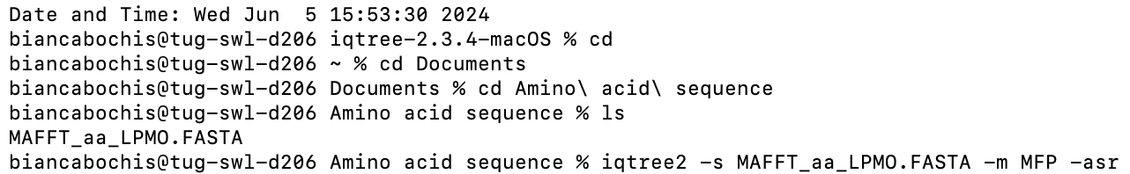
Commands
MFP: tells the IQTREE software to use Model Finder Plus to determine the best fit model for sequence evolution

Slide 11
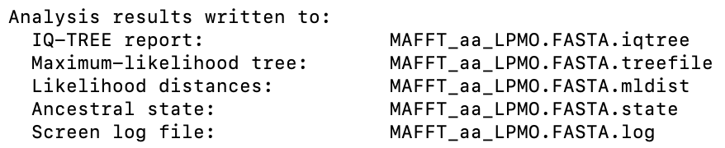
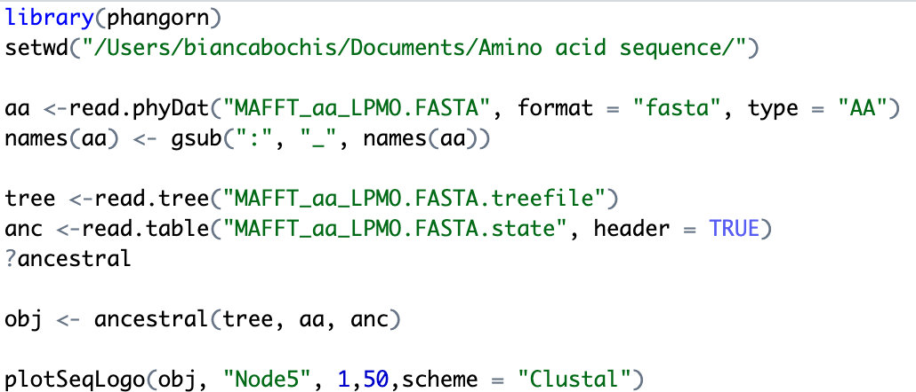
The Output
Files saved to the same folder as the data file
Need to use a simple text editor or R to make the data visible

Slide 12
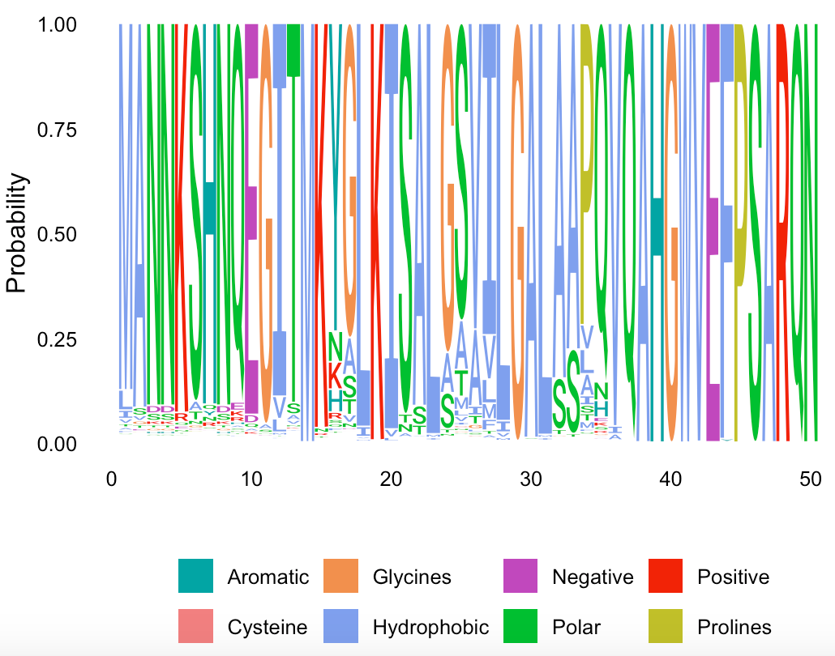

Slide 13
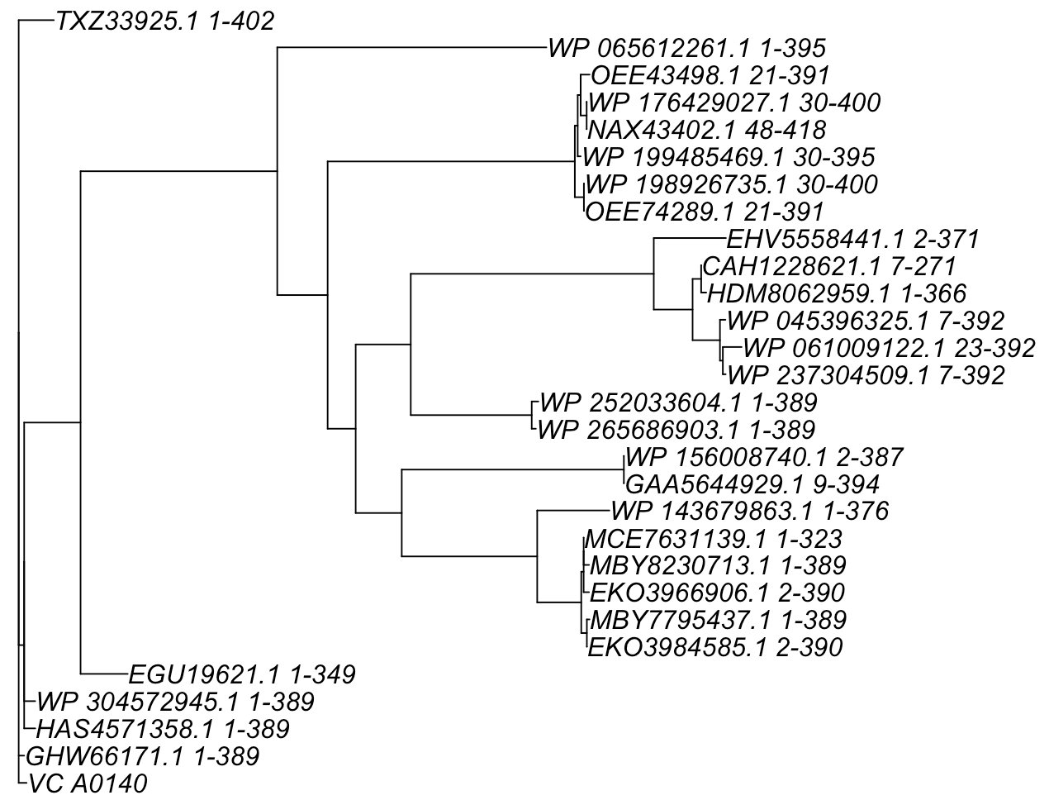

Slide 14
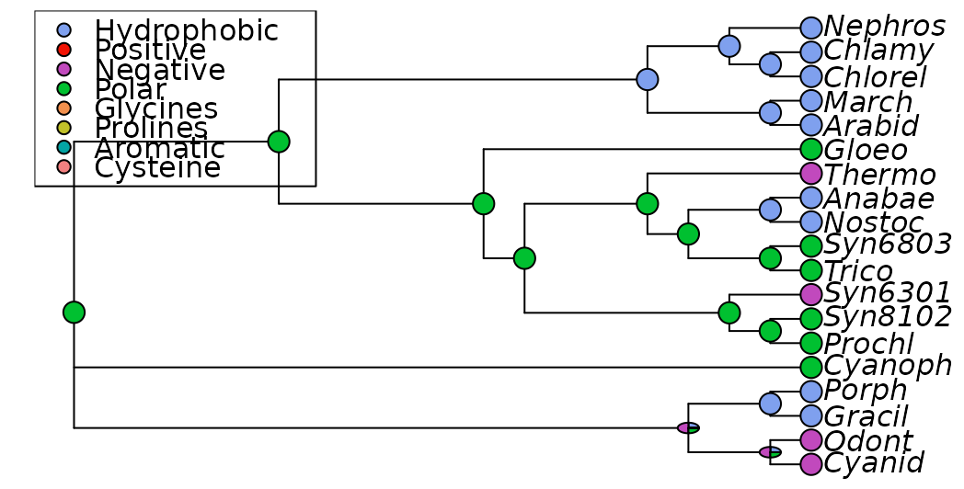

Slide 15
Any Questions?

